Slide 2

Before we get started

Slide 3



About me
Agenda
Manager Analytics, Krakow
Team of 8 people
~$4B Segment
~10 years python experience
5 years financial analyst
Outside work
Kayaking, hiking, cooking
Business Case for data products
Install
Version control (git)
Python
First exercises
SQL
Pandas

Slide 4





Krzysztof Gałka
Agenda
Engineer
Mechatronics
Industrial automation
Business
Outside work:
Skiing
3d printing
Solving problems
Learning
Cycling
Kitesurfing
Business Case for data products
Install
Version control (git)
Python
First exercises
SQL
Pandas
I am a horse. I can’t help you… ;(

Slide 5
Data Product Business Case
Bonus Incentive Plans
~1,000 participants
$$ costs in the millions

Slide 6


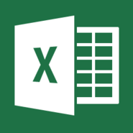

Calculating Bonus Plans for ~1,000 people world wide
Individual Reporting
TED Indirect Sales
TED Direct Sales
Employees information
Updated results
Bonus Letters
Targets
Calculate actuals vs targets
Payouts Calculations
Salesforce pipeline and conversion

Slide 7

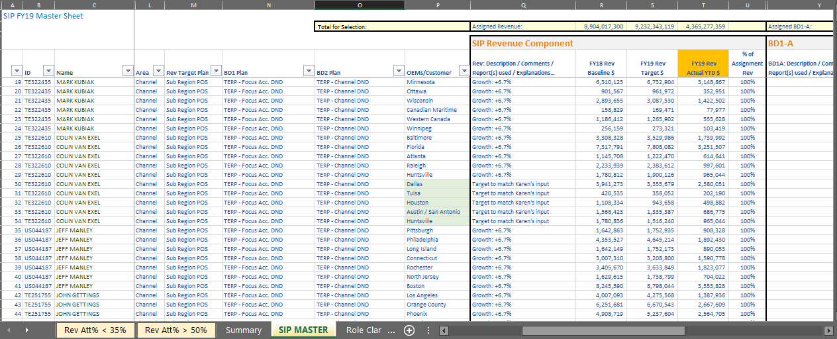
Blending datasets manually -> errors and resource issues
Multiple deliveries that are hard to manage due to the high number of sales people in the BU
Individual Reporting
Multiple data sources to be consolidated and kept in sync manually
TED Indirect Sales
TED Direct Sales
Employees information
Updated results
SIP Letters
Targets
Payouts
Salesforce pipeline and conversion
Manually calculate actuals vs targets for each SIP/PMIP KPI

Slide 8
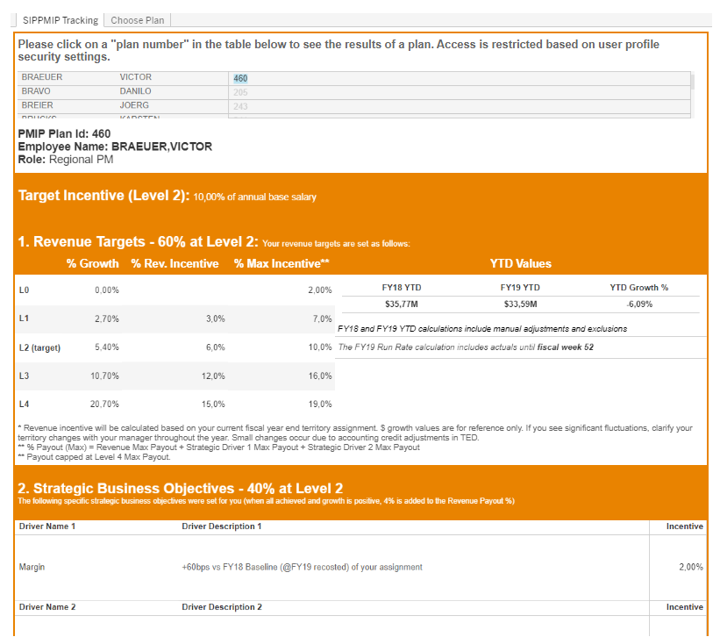
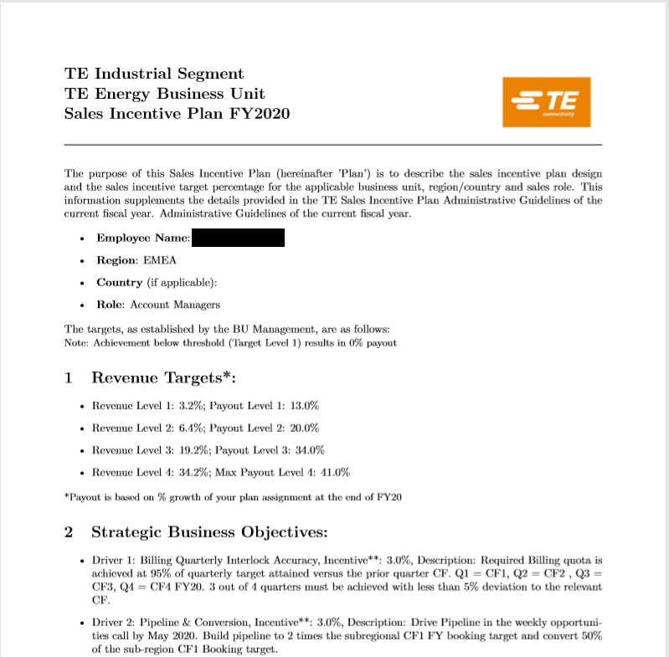

Data Product -> automate, consolidate, avoid errors
Individual Reporting
1
Individual reports are automatically refreshed
TED Indirect Sales
TED Direct Sales
Employees information
Data
SIP Letters
2
Updated results
Targets
Salesforce pipeline and conversion
3
Data is consolidated and managed by application.
No more manual updates
Payouts
Automatically calculate actuals vs targets for each SIP/PMIP KPI
Letters are created and sent automatically

Slide 9




The world is changing
Increasing data content
Too much data!
Too much data!

